Slide 1
Phase Locked Loop (PLL)
With the advancement of integrated-circuit technology PLL circuits became fundamental building blocks in modern electronics
PLLs are widely used in systems such as FM stereo decoders, motor speed control systems, tracking filters, frequency synthesizers in transmitters and receivers, FM demodulators, FSK decoders, and local oscillator generation in TV and FM tuners.
A phase-locked loop consists of three main components:(1) Phase detector, (2) Low-pass filter, and (3) Voltage-controlled oscillator (VCO).
The phase detector compares the input frequency 𝑓𝑖​ with the feedback frequency from the VCO and produces an output proportional to their phase difference.
The output of the phase detector is a dc voltage proportional to the phase error, commonly called the error voltage.
The low-pass filter removes high-frequency noise and ripple from the detector output and produces a smoother dc control voltage.
In addition to filtering noise, the low-pass filter also determines the dynamic response and stability of the PLL.

Slide 2
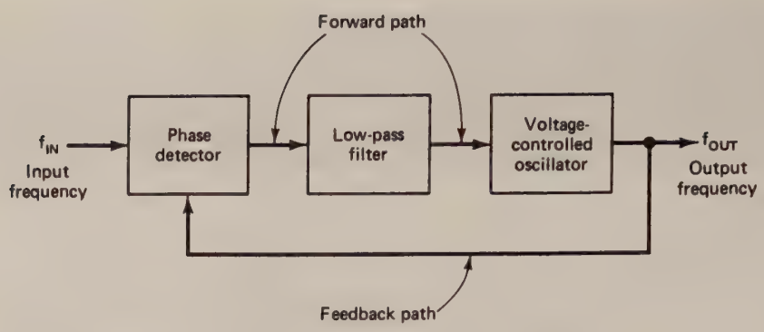
Phase Locked Loop (PLL)
The filtered dc voltage is applied to the voltage-controlled oscillator, whose output frequency is directly proportional to the input control voltage.
The VCO output is continuously compared with the input signal, and its frequency is automatically adjusted until both signals match.
Before the input signal is applied, the VCO oscillates at its natural free-running frequency called free running state.
When the input signal is applied, the VCO frequency begins to change under the influence of the control voltage, and the PLL enters the capture mode.
When the VCO frequency becomes equal to the input frequency, the loop reaches the phase-locked condition.
Once locked, the PLL can track small changes in the input frequency by continuously adjusting the VCO frequency.

Slide 3
Phase detector
The PLL tries to force a Voltage Controlled Oscillator (VCO) to follow the phase and frequency of an input signal.
If two periodic signals are compared:
If their phases are identical → error = 0
If one leads or lags → error ≠ 0
The phase detector converts this phase difference into a voltage called the error voltage.
This voltage then passes through a loop filter and adjusts the VCO frequency until the phase difference becomes zero (or a fixed value depending on detector type).
Types of Phase Detectors
Analog Phase detectors
Digital phase detectors

Slide 4
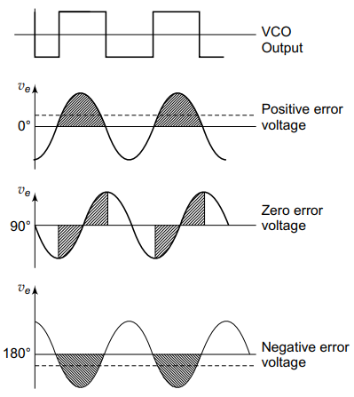


Analog Phase detector
An analog switch is controlled by the VCO output.
The output error voltage becomes phase dependent.
Let input=
And output of VCO:
The phase detector basically multiplies the signals.
The filter removes the high frequency component. The output becomes
When both frequencies are matched it becomes:

Slide 5
Analog Phase detector
The PLL lock occurs when phase difference is 90 degrees.
When the phase difference is positive it generates a positive error voltage.
When phase difference is between 90-180 it generates a negative error voltage.
Limitation:
The error output voltage is dependent on the input signal amplitude.
The non-linear response (cos(phase_difference)) is hard to control.

Slide 6

Digital Phase detector
Digital phase detectors require square wave inputs.
They compare the timing of edges rather than waveform amplitude.
Three types are commonly used.
EXOR Phase detector
SR Flip flop phase detector
The XOR phase detector uses an EXOR gate for the phase detection
The XOR gates goes high when both the signals are different.
So as long as the two signals have different edge timings, the XOR gate goes high generating a pulse signal.
The higher the phase difference the greater is the pulse width.
Based on pulse width the error voltage is generated and supplied to the VCO for frequency tuning.
The error voltage is highest for 180 degrees and lowest for 0 degree phase difference.
However, it works well only if both the signals are perfect square waves with 50% duty cycle.

Slide 7
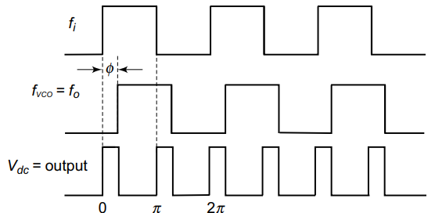
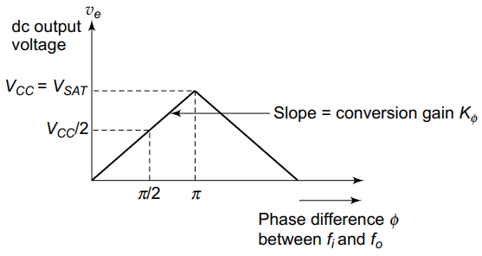
Digital Phase detector

Slide 8
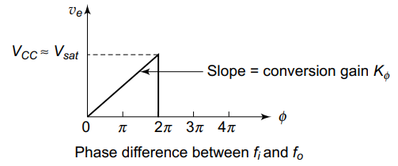
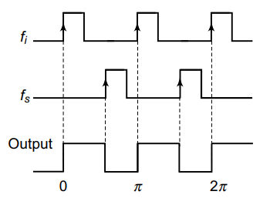
SR Flip flop Phase detector
Uses an RS latch built using NOR gates.
Input frequency =set
VCO output=reset
input edge arrives → output set HIGH
VCO edge arrives → output reset LOW
Therefore the output remains HIGH during the time difference between the edges.
The average value of Q output
Vdc∝phase difference
Advantages Compared to XOR detector:
Linear over full 360°
Better capture range
Better lock stability
Better tracking performance

Slide 9
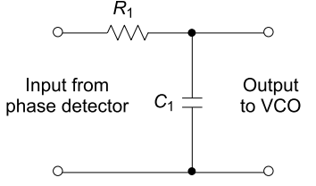
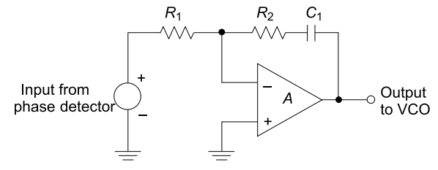
Low pass filter
Uses an RS latch built using NOR gates.

Slide 10
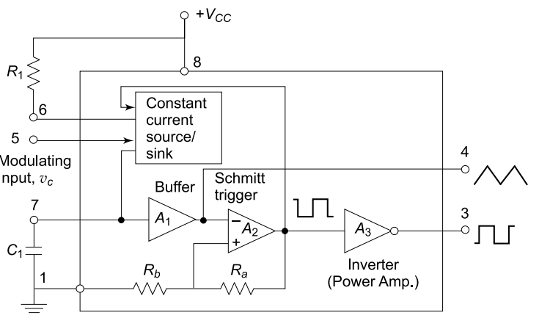
VCO
Uses an RS latch built using NOR gates.

